Slide 1
Testing Coverage Analysis for Software Component Validation
Raquel Espinoza
San Jose State University
COMPSAC 2005
Edinburgh, Scotland
July 26-28, 2005

Slide 2
Agenda
Introduction
Related Work
Test Model Concept
Coverage Criteria
Tool Architecture
Application Example
Conclusion
Recommendations
COMPSAC 2005

Slide 3
Introduction
Motivation: support widely used method of incorporating reusable software components to develop larger software systems to reduce development cost, effort and time
Problem: How to adequately test these large software systems prior to release
  If individual reused software components are not adequately tested, it may be difficult and time consuming to isolate the source of a problem
Solution: Begin testing at the component level to weed out component quality problems and address reuse context issues prior to incorporation
Proposed Method: A model-based coverage analysis method to address adequate testing of a components API in the validation for its reuse
COMPSAC 2005

Slide 4
Related Work
S. H. Edwards define a black-box test model, known as flow graphs, derived from a component’s specification and applied analogues to traditional graph coverage techniques to develop a test set generation approach.
D. Hoffman and P. Strooper define a state-based test model, known as a testgraph, to model a class-under-test (CUT) as a state machine and applies graph traversal techniques for test input generation and develops driver and oracle classes to support test execution.
S. Beydeda and V. Gruhn define a test model derived from a class specification and implementation and present it as a control flow graph to support structural testing techniques, such as coverage criteria-based techniques, for use in test case generation.
D. S. Rosenblum defines two formal test models that address adequate unit testing and integration testing of components. These models are defined based on the subdomain-based test adequacy criteria defined by Frankl and Weyuker.
COMPSAC 2005

Slide 5
Proposed Method
A model-based coverage analysis method for a component API to address adequate testing issue in validation for reuse
  Define a test model that represents a component’s API interface
  Identify coverage criterion for a test model
  Dynamically analyze and monitor test coverage by evaluating test scenarios to determine percent of coverage provided
COMPSAC 2005

Slide 6
Academic Contribution
To establish a dynamic test coverage analysis method that provides identification of higher quality test sets that can offer adequate test coverage at the component level
To offer a more effective testing method for a components API
COMPSAC 2005

Slide 7
Test Model Concept
A test model represents a component’s API interface and semantics that define constraints and usage of the interface
  Each accessible interface method is defined as a “node”
  Each possible interface method call between a pair of nodes is defined as an edge or “link”
  A link may be “conditional” when an accessible element or state of the component represents an operation constraint of the interface method call
COMPSAC 2005

Slide 8
Component API Interface
Single API
  API has a complete set of
  accessible methods
  API defines usage by another
  system component
Multiple APIs
  Each API has subset of
  accessible methods
  Each API defines usage by
  different system components
C1
API₁ (F₁ … F_{n})
G
C1
API₁ (F₁ … F_{i})
API₂ (F_{i+1} … F_{n})
G
C2
COMPSAC 2005

Slide 9
Test Model Notation
Analytical expression: G = (F,E)
  G: test model for a component
  F: set of all nodes
  E: set of all links
F_{i} is accessible interface method of G
E_{n} = (F_{i}, F_{j}) describes the method access sequence of F_{i} then F_{j}
COMPSAC 2005

Slide 10
Test Model Representation
Types
  Component Functional Access Graph (CFAG): visual representation of the test model structure
  Dynamic Component Functional Access Graph (D-CFAG): visual representation of the execution sequence of a test scenario for a given CFAG
Purpose
  To assist engineers in defining various test criteria
  To facilitate automatic test generation
  To facilitate test coverage analysis
COMPSAC 2005

Slide 11
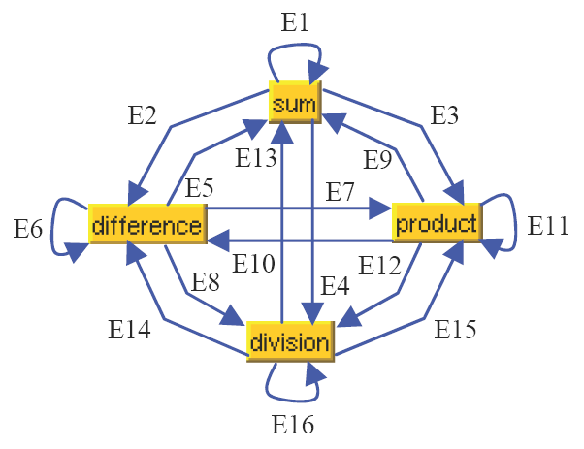
CFAG Example:
Simple Calculator Component
Single API
Nodes: sum, product, difference, division
Links: E1 thru E16
Conditional links: E4, E8, E12 and E16 where the condition addresses division by zero
Total links: n² where n = number of nodes
COMPSAC 2005

Slide 12
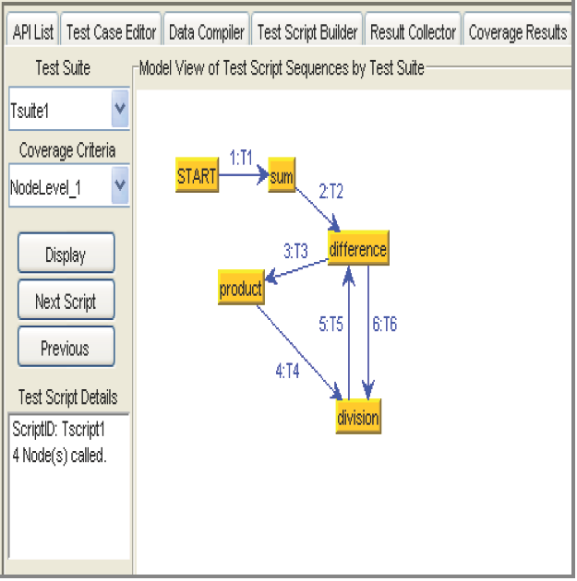
D-CFAG Example:
Simple Calculator Component
One possible test scenario with 6 test cases
All 4 nodes exercised
Only 5 out of 16 links exercised
COMPSAC 2005

Slide 13
Coverage Criteria
Metric used to assess the effectiveness of a set of tests to exercise the functionality offered by a software component for the purpose of exposing defects
Coverage criteria target specific characteristics of the software component’s structural or behavioral properties
Coverage criteria considered:
  Node coverage criteria for each accessible method in an API interface
  Link coverage criteria for each link between two nodes
  Conditional link coverage criteria
  Path coverage criteria for API access sequences between the nodes
COMPSAC 2005

Slide 14
Coverage Criterion
Node: achieved for node F_{i} in G if and only if its adequate test set TF_{i} has been exercised
All-node: achieved if and only if every node F_{i} in G has achieved its node coverage criterion
Link: achieved for link E_{n} = (F_{i},F_{j}) in G if and only if F_{i} has been exercised at least once using the test set TF_{i} followed by exercising F_{j} using the test set TF_{j}
All-link: achieved if and only if every node E_{n} in G has achieved its link coverage criterion
Condition-link: achieved for conditional link E_{i} in G if and only if E_{i} is exercised with two test cases such that both TRUE and FALSE conditions are tested
All-condition link: achieved if and only if every conditional node E_{i} in G has achieved its condition-link criterion
Path: achieved for P_{k} in G where P_{k} = (E_{i}, E_{j} … E_{n}) if and only if P_{k} is exercised at least once in a sequence E_{i}, E_{j} … E_{n} by a test script in the test set T for G.
Minimum-set path: achieved if and only if there exists a path set P (for E_{i} to E_{n}) which covers all nodes and links reachable from E_{i} to E_{n} and is traversed by test scripts in test set T.
COMPSAC 2005

Slide 15
Applying Test Coverage to API
Component C has a single API interface and black-box test set T with N test scenarios
  CFAG for C is G = (F, E)
  i-th D-CFAG for C that represents the i-th test scenario in T from 1 to N is G_{i} = (F[i], E[i])
Determine set of nodes and links achieving desired coverage using union operation
  Covered-Node-Set = F[1] U F[2] U … U F[N]
  Covered-Link-Set = E[1] U E[2] U … U E[N]
  Uncovered-Node-Set = F – Covered-Node-Set
  Uncovered-Link-Set = E – Covered-Link-Set
COMPSAC 2005

Slide 16
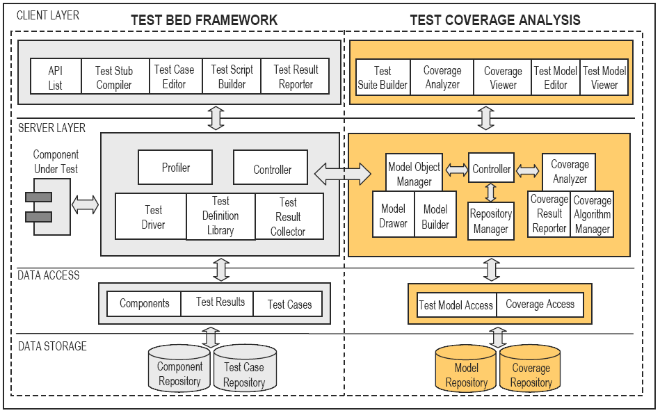
Tool Architecture
Incorporated concepts into an automated testing application to provide test model generation and coverage analysis
COMPSAC 2005

Slide 17
Tool Functionality
Test coverage analysis
  Automatic generation of test models (CFAG)
  Editing of test models
  Creating test suites (sets of test scenarios)
  Setup of the coverage analyzer for selected criterion
  Executing of the coverage analysis
  Viewing test scenario sequences (D-CFAG)
  Viewing of coverage results
  Storing test models and coverage results
Test-bed framework
  Loading profiles of component’s API
  Creating test case and test scripts
  Executing test scripts on the loaded components
  Viewing test result
COMPSAC 2005

Slide 18
Application Example:
BTree Component
Single API
Component includes two classes
  BSTree: API interface
  BSTNode: object class
Test set T containing three test scenarios T₁, T₂ & T₃ generated to exercise in different ways the inserting elements, removing elements and verifying BTree structure after insertion/removal
  T₁ execute 18 method calls
  T₂ & T₃ execute 13 method calls
All test scenarios were analyzed for both node and link coverage
COMPSAC 2005

Slide 19
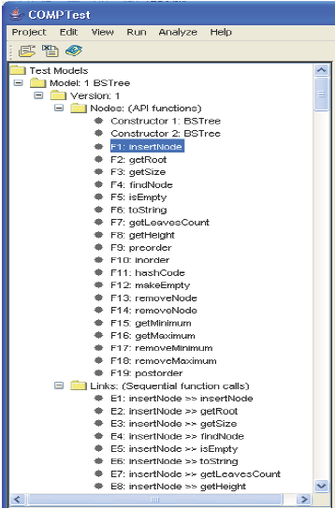
CFAG Representation
BTree interface has 19 accessible methods
  G = (F,E)
  F = F₁ … F₁₉
  E = E₁ … E₃₆₁
A tree structure is used to display the CFAG
Selection of a node or link will display more information such as link conditions
COMPSAC 2005

Slide 20
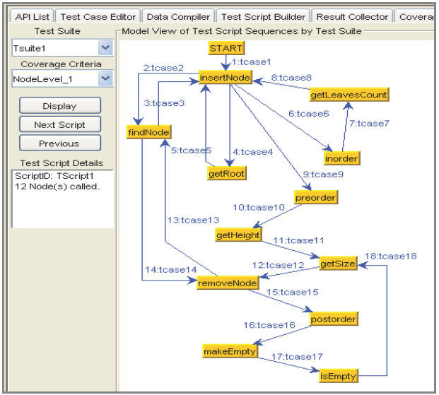
D-CFAG Representation
G_{T1} = (F[T₁], E[T₁]) (SHOWN)
  18 calls to 12 nodes
  Node coverage 55%
  Link coverage 4.5%
G_{T2} = (F[T₂], E[T₂])
  13 calls to 8 nodes
  Node coverage 45%
  Link coverage 2.9%
G_{T3} = (F[T₃], E[T₃])
  13 calls to 11 nodes
  Node coverage 55%
  Link coverage 3.2%
COMPSAC 2005

Slide 21
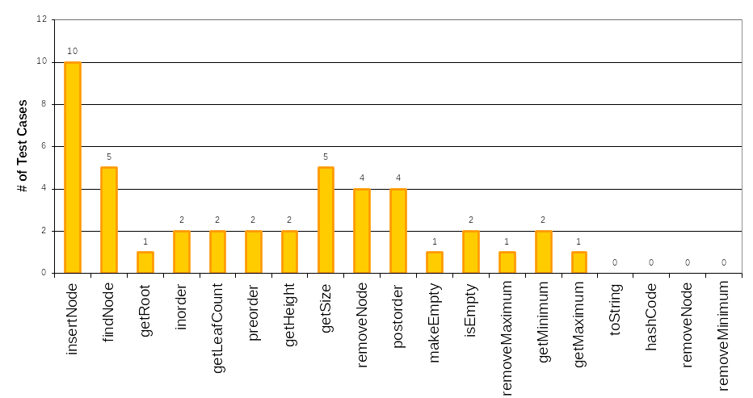
Coverage Analysis Result:
Node Coverage Criterion
Covered-Node-Set = F[T₁] U F[T₂] U F[T₃]
3 test scenarios provided a total node coverage of 78.9%
COMPSAC 2005

Slide 22
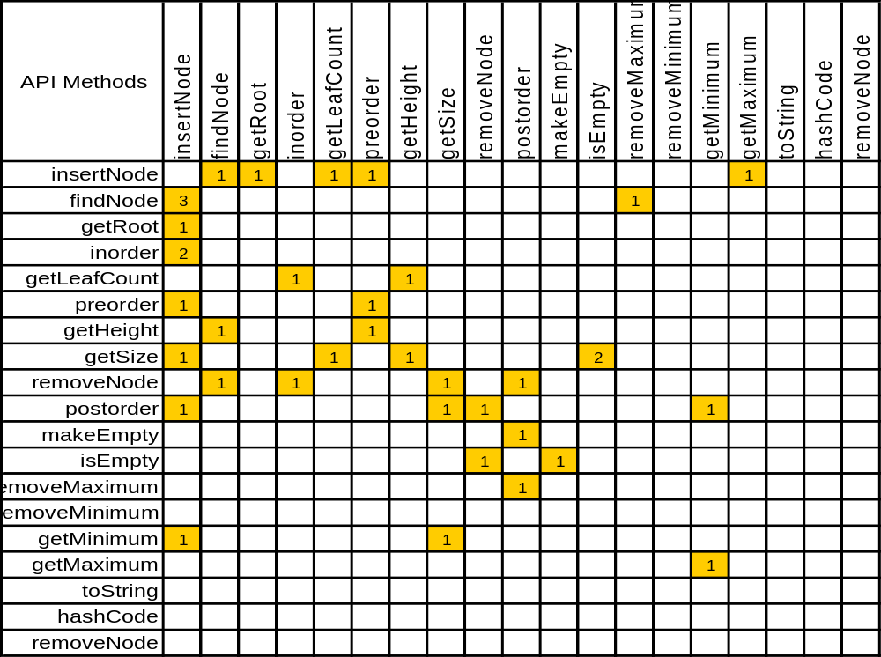
Coverage Analysis Result:
Link Coverage Criterion
Covered-Link-Set = E[T₁] U E[T₂] U E[T₃]
3 test scenarios provided total link coverage of 9.4%
COMPSAC 2005

Slide 23
Conclusion
A basic framework is proposed for generating test models (CFAG and D-CFAG) based on a component’s API interface and developing a set of coverage criteria for the models
Challenges for this method:
  Developing a test model that sufficiently represents an component API
  Displaying the test model and coverage results in a comprehensive manner
  Defining adequate coverage criterion for the test model
  Defining a test set that provides adequate test coverage
This method provides revealing coverage metrics by facilitating the identification of higher quality test sets that can offer adequate test coverage
It is a first step towards defining a more effective component-level unit testing method for a component’s API
COMPSAC 2005

Slide 24
Recommendations and Future Work
Develop coverage criteria that identify high risk areas that should be tested
Develop test models and test coverage methods to address adequate testing for component reuse at the component integration and system level
Future research efforts will be dedicated to:
  Develop a systematic solution for a minimum path-set
  Apply current research to components with different types of interfaces and components with multiple APIs
  Extent the test models to represent component interaction patterns and develop related coverage criteria
COMPSAC 2005

